Slide 1
FUNDAMENTALS OF DATA ANLYSIS AND VISUALIZATION
DAY 1

Slide 2
Day 1 Goals
Be able to:
Understand the benefits of programming
Develop an organized filing structure
Become familiar with Stata software/ interface
Read a Stata help file and know where to find additional help online
Import data into Stata
Reproduce fundamental Stata commands around summarizing data and creating variables

Slide 3
DAY 1 AGENDA
Introductions
Why use statistical software?
Laying a foundation for data analysis
Foreign Assistance Dashboard data overview
Working with Stata
Exercise and review
Homework assignment & next week’s agenda

Slide 4
Motivation
Notes:
Reproducibility: ability of a study or analysis to be completely reproduced
Idea: ultimate product is the final report + full computational environment necessary to reproduce deliverable(s)
Why: Can you really trust the results?
Are the results accurate?
What assumptions were made along the way?
Can you audit the report/study?
Was it done efficiently?

Slide 5
WHAT IS STATA?
The Answer to the Ultimate Question of Life, The Universe, and Everything?
?
X | Y | Z
9 | 2 | 1
7 | 5 | 1
1 | 7 | 2
42
Stata
Notes:
Why and when to use Stata over Excel?
data manipulation - cleaning, generating new variables, generating summary data sets, merging (and finding merging errors), collapsing cross-section time series data, reshaping datasets from long to wide
statistics - bivariate and multivarate statistical tools - from descriptive statistics and t-tests, OLS regrestions, two-statge least squares, logits, probits, model simulations, bootstrapping, maximum likelihood estimate
graphics - high quality 2-d graphics in several dozen formats
repeated tasks - do files (and loops)

Slide 6
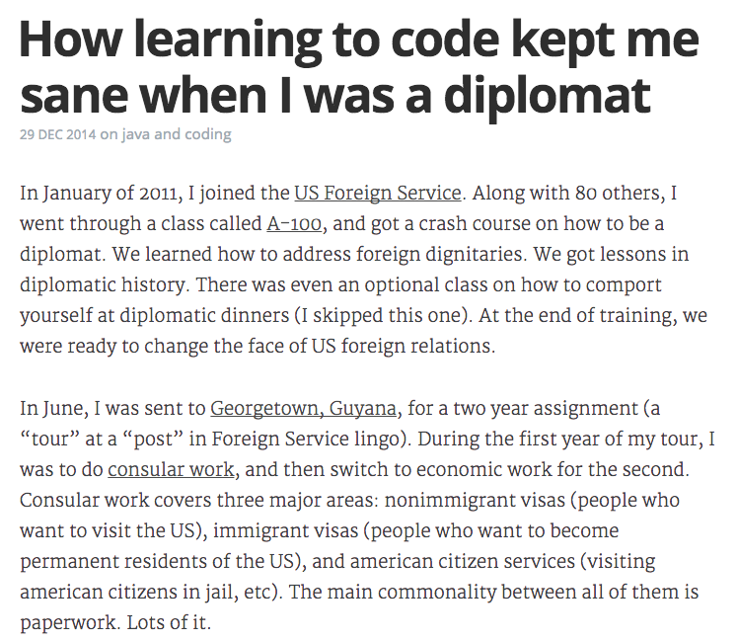
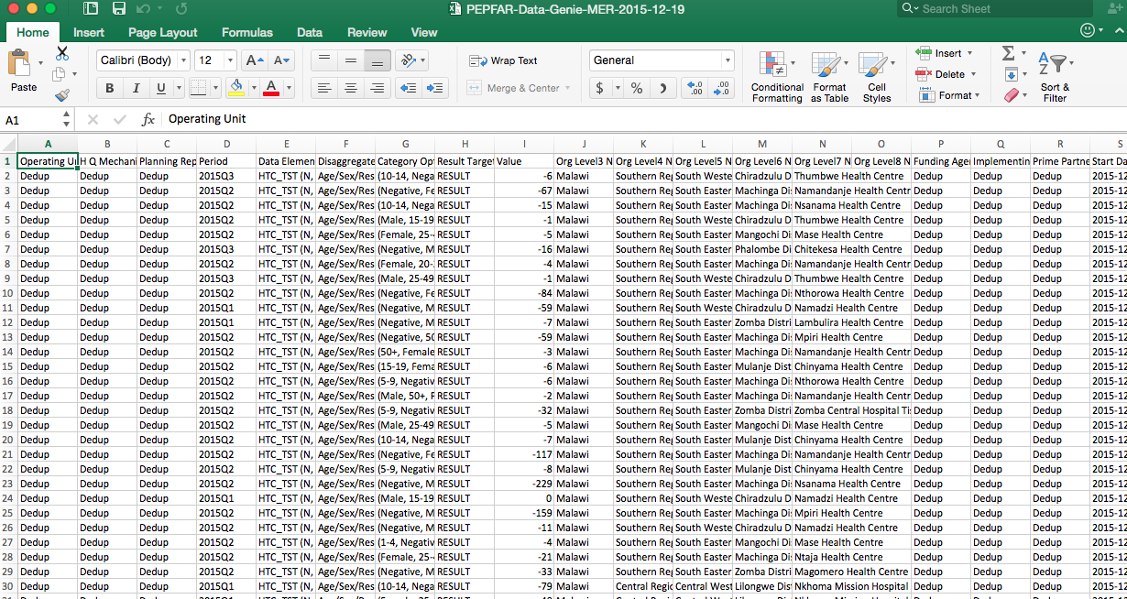
AUTOMATE REPETITIVE TASKS
Notes:
Blog post from http://www.vikparuchuri.com/blog/how-learning-to-code-kept-me-sane/

Slide 7

TIM’S PRINCIPLES OF DATA ANALYSIS
1
2
3
4
Having a Plan for Your Analysis
Organized Project via Filing
Consistency in Naming Conventions
Nested Code Containing Frequent Notes
Notes:
Icons from the Noun Project: iconsmind.com

Slide 8
1. HAVE A PLAN AND TAKE STOCK OF YOUR PROGRESS
Notes:
Having a working problem
The whole project up into smaller, manage pieces
Try to save projects to portable places (especially when working collaboratively): Github, Dropbox, etc
Photo Source: http://ichef-1.bbci.co.uk/news/624/media/images/81084000/jpg/_81084019_everest_route_624_v2.jpg

Slide 9


2. FILE STRUCTURING
FAD_analysis
documents
data
fad.csv
fad.csv.zip
wdi.csv
wdi.csv.zip
drv_fad_wdi_merge.dta
stata
out
_manifest.do
01_data_cleaning.do
02_merge_fad_wdi.do
descriptive_stats.do
analysis.do
README.txt
Consistent filing structure benefits us by making it easier to find and save files; makes it easier for collaboration; easier to pickup past projects
Separate out data, code, and other documents; protect raw data by zipping it; identify derived datasets (drv_) and any temporary files (temp_)
Break out long code into multiple do files, splitting the cleaning from the analysis; add a manifest do file that can run all the do files in project
Adding README document is allows someone else (or you down the road) to be able to understand the project and reproduce it with the raw data
Notes:
Reference: https://www.maxmasnick.com/analysis-org/
Icons from Noun Project: Edward Boatman; Schmidt Sergey; Rigo Peter; iconsmind.com; Thi Dieu Linh

Slide 10
3. NAMING CONVENTIONS
Stata is case sensitive; there is no right or wrong naming conventions, but you should stick with a naming convention that is intuitive, logical, and consistent across your project
Notes:
Useful to have meaningful naming conventions, but it can get out of hand.
Pick a useful convention and stick to it (eg all lower, adding abbreviations for categories like derived variables, temporary variables, binary variables, etc)
Source: http://dilbert.com/strip/2011-04-23

Slide 11
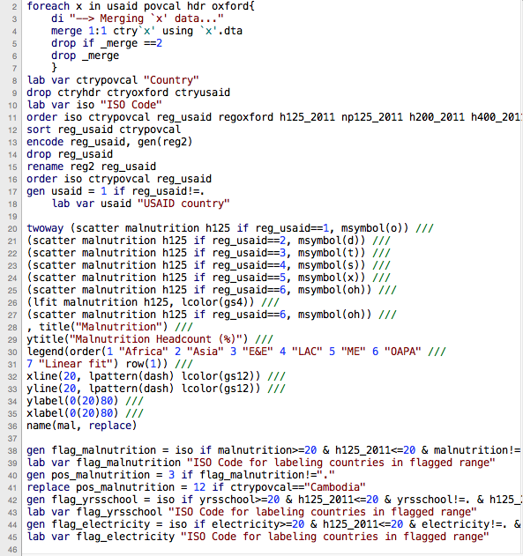
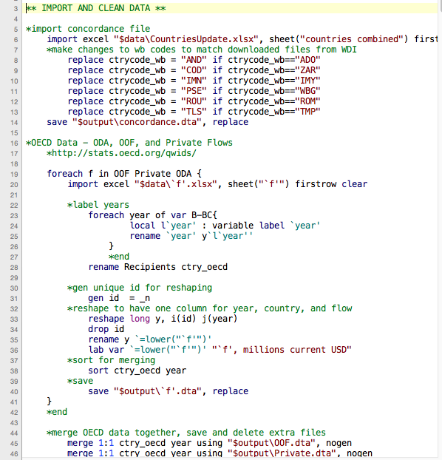
4. Clean Code
Poor Coding
Better Coding
Notes:
Nest code to make it easier to read and keep it from becoming to complex
Comment frequently about what you’re doing with the code so others or your furture self can understand and reproduce the analysis
Break up code into smaller files rather than having one very long do file

Slide 12
DATA ANALYSIS
Notes:
Icons from the Noun Project: iconsmind.com

Slide 13
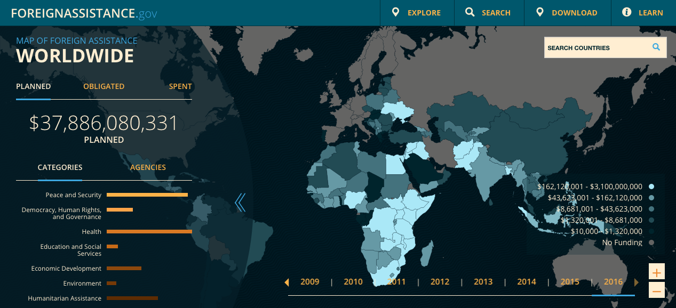
Foreign Assistance Dashboard (FAD)
Notes:
Site/data aim is “improving transparency in U.S. foreign assistance spending”
Quarterly reporting on US foreign assistance
Includes data from multiple agency – Ag, Comm, DoD DoE, HHS, Interior, DoS, Treasury, MCC, Peace Corps, USAID and others
Data dates back to 2006 for some agencies
Reporting on planning, obligations, and spending, categorized by year, country agency, category, sector, etc
We’ll be using a sample of the data for the entirety of the course
Source: foreignassistance.gov

Slide 14

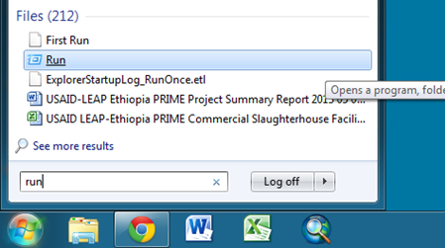
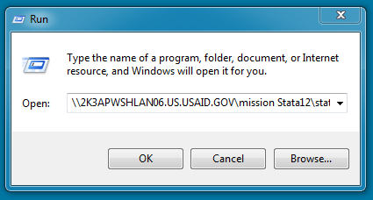
ACCESSING STATA
1) Open up the Start Menu in the lower left hand corner of your screen
2) In the search programs and files, type “Run” and select the “Run” application
3) Once “Run” is open, paste the file location in the blank field.
\\2K3APWSHLAN06.US.USAID.GOV\
mission Stata12\stata.exe
4) When you hit “OK,” this will launch Stata

Slide 15
STATA SYNTAX
[by varlist:] command [varlist] [=exp] [if exp] [in range] [weight] [, options]
varlist – list of variable names
exp – algebraic expression
range – observation range
weight – weighting expression

Slide 16

NAVIGATING FOR HELP
help
Notes:
How to navigate through help documentation in Stata
Searching for help online – Stackoverflow and Statalist

Slide 17
Stop. It’s Hammer Time.
Notes:
GIF: http://www.dancespirit.com/news/cant-touch/
Stata Logo: http://www.stata.com/why-use-stata/i/stata_logo_med_blue-375.png

Slide 18
GROUP EXERCISE I
Import exercise file into Stata
Determine how many string and numeric variables there are
Report the average spending on Infrastructure for Afghanistan
Which category received the most funding in Kenya in 2013? How much?

Slide 19
Stata
Notes:
Poster – http://cdn.collider.com/wp-content/uploads/Back_to_the_Future_rerelease_movie_poster.jpg
Font - http://http://www.dafont.com/back-to-the-future.font

Slide 20
GROUP EXERCISE II
Create a binary variable for any USAID observations
Label the variable, and create variable labels where “0” is “No” and “1” is “Yes”
Create a table summarizing total USAID vs other spending by year

Slide 21
Stata
Notes:
Poster – http://cdn.collider.com/wp-content/uploads/Back_to_the_Future_rerelease_movie_poster.jpg
Font - http://http://www.dafont.com/back-to-the-future.font

Slide 22
HOMEWORK ASSIGNMENT
TBD

